Slide 1



Presentation 2024
TEXT SUMMARIZATION
Mentor: Mr. Narendra Kumar
Intern: Nikhilkumar A. Jain
Group 2
2024
Jain Nikhilkumar A
1

Slide 2

Overview
Introduction
Problem Statement
Project Planning
Architecture
Workflow
Dataset
Model Training
Model Evaluation
Testing
Deployment
Deployment - Results
2024
Jain Nikhilkumar A
2

Slide 3


INTRODUCTION
Problem Statement & Planning
2024
Jain Nikhilkumar A
3

Slide 4
Problem Statement
Developing an automated text summarization system that can accurately and efficiently condense large bodies of text into concise summaries is essential for enhancing business operations.
This project aims to deploy NLP techniques to create a robust text summarization tool capable of handling various types of documents across different domains.
The system should deliver high-quality summaries that retain the core information and contextual meaning of the original text.
2024
Jain Nikhilkumar A
4

Slide 5
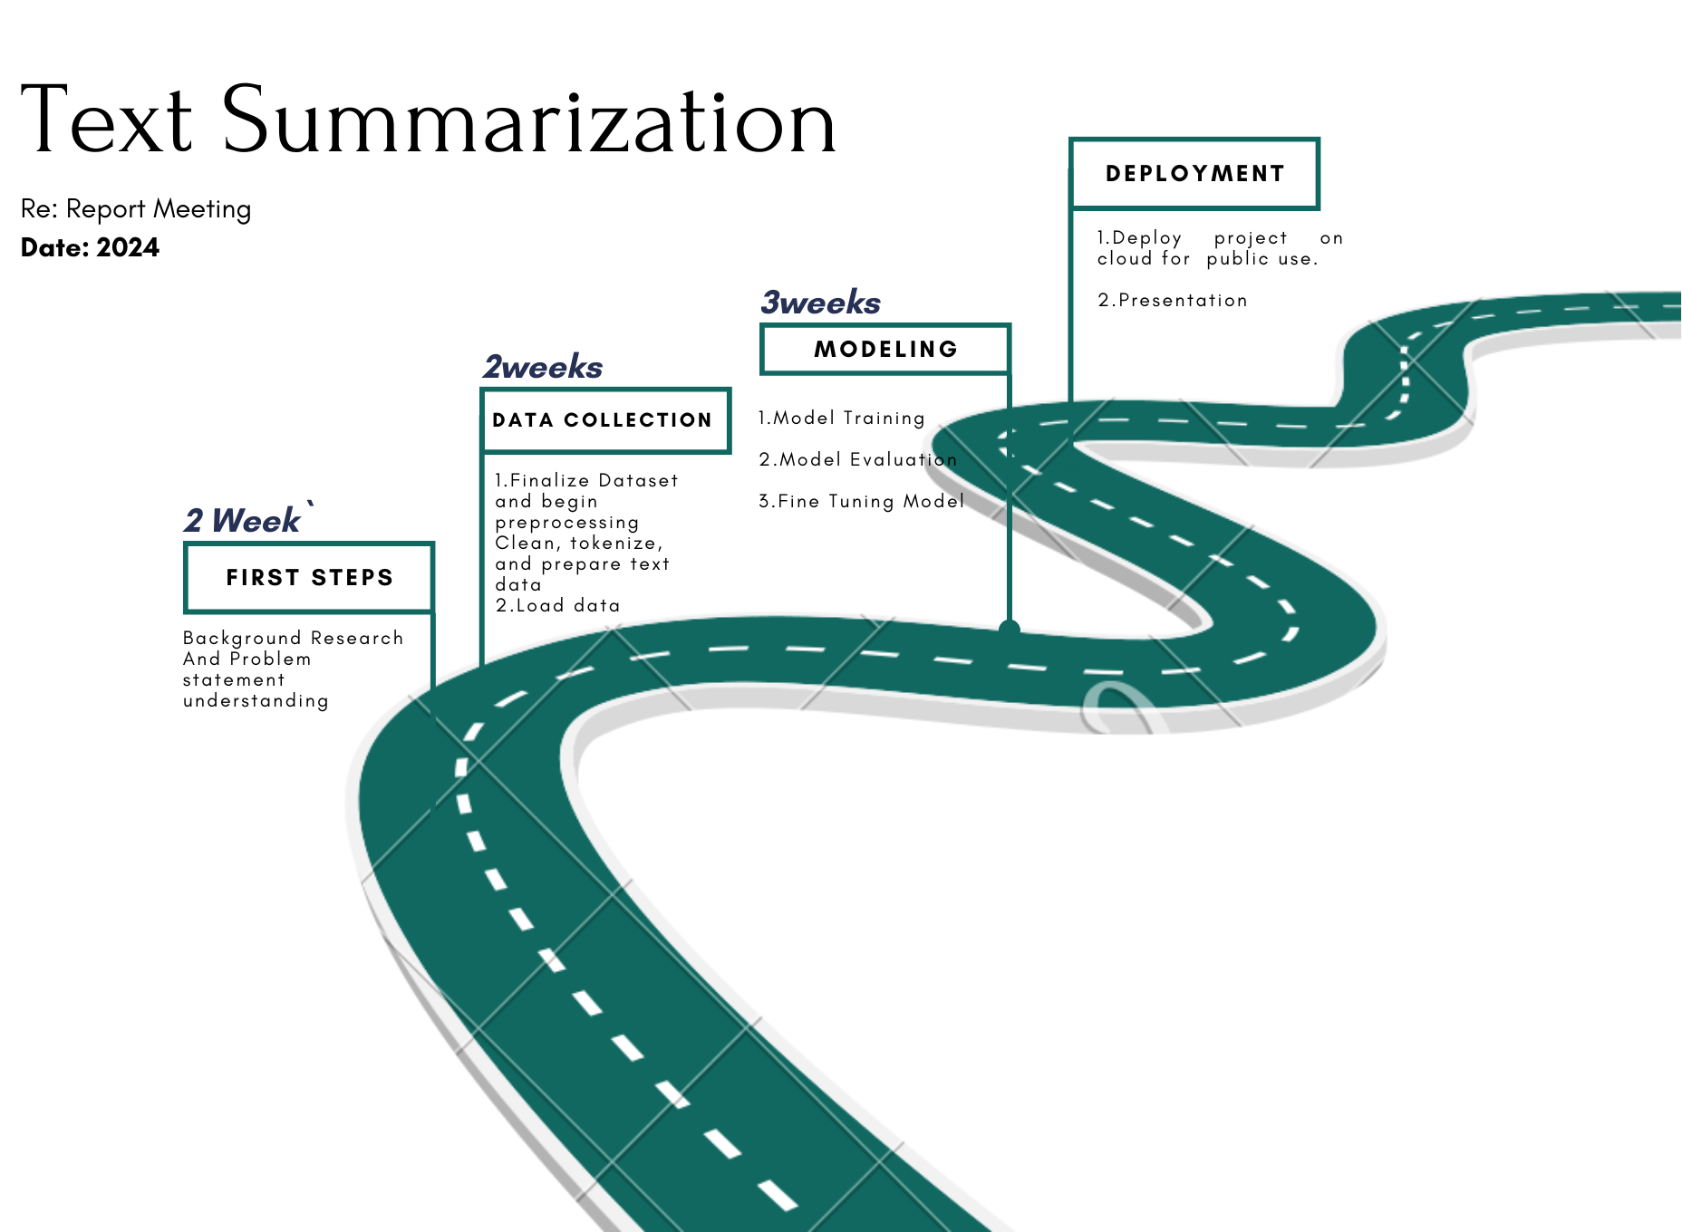
Project Planning :
2024
Jain Nikhilkumar A
5

Slide 6
ARCHITECTURE
Selected Architecture And Methods
2024
Jain Nikhilkumar A
6

Slide 7
Methods Available :
Implementation methods:
Leveraging Pre-trained Pegasus Model
Training from the Ground Up
Load Pre-trained Model:
Construct the Model:
Use pre-trained Pegasus models.
Develop Pegasus architecture from the basics.
Fine-Tune for Specific Tasks:
Implement gap-sentence generation techniques
Tailor the model using your dataset.
Neural Network Configuration:
Performance Evaluation:
Set up layers, attention mechanisms, etc.
Assess effectiveness on your tasks.
Initialize Parameters:
Advantages:
Establish initial weights and biases.
Extensive Data Training:
Focus on task-specific innovation.
Efficient resource usage.
Gather and process a large dataset.
Engage in long-duration training.
Practical and feasible.
Challenges:
Scalable and adaptable.
Highly resource-intensive and time-consuming
Inefficient resource utilization.
Often impractical for many projects.
2024
Jain Nikhilkumar A
7

Slide 8
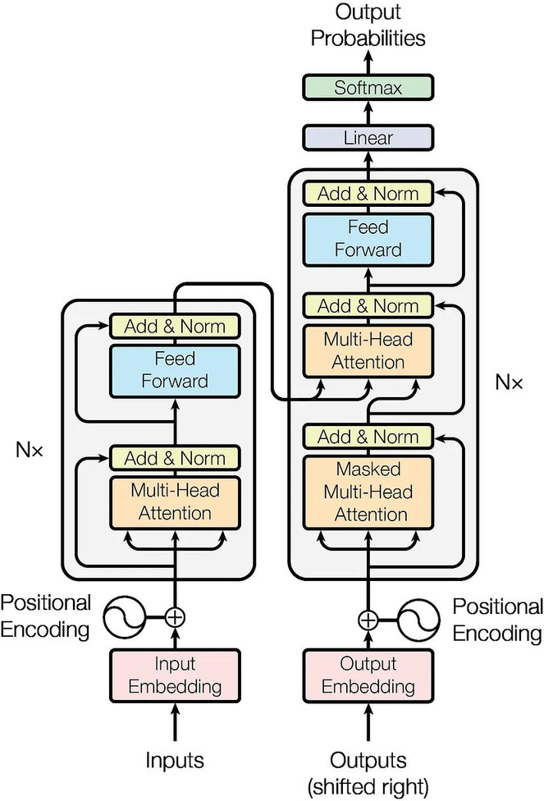
Selected Architecture :
Leverage Pegasus Strengths: Pegasus is specifically designed for abstractive summarization, making it a great choice for generating summaries that capture the essence of the text without simply copying sentences.
Domain-Specific Tuning: Fine-tune Pegasus on CNN/Daily Mail and XSum to improve its understanding of news language and structure. This will help it generate summaries that are relevant and informative for news articles.
Focused Training: Fine-tuning requires training only a portion of Pegasus, focusing its learning on news summarization tasks. This leads to faster training times and more efficient model updates.
Continuous Learning: Fine-tuning allows you to easily adapt Pegasus to new types of news data in the future. As news formats evolve, you can fine-tune it to stay relevant.
Striking a Balance: As with other models, find the ideal balance between leveraging Pegasus's pre-trained abilities and specializing it for news summarization. This ensures it can handle unseen news articles effectively.
Transformer architecture
2024
Jain Nikhilkumar A
8

Slide 9
PROPOSALS
Proposals And Workflow
2024
Jain Nikhilkumar A
9

Slide 10
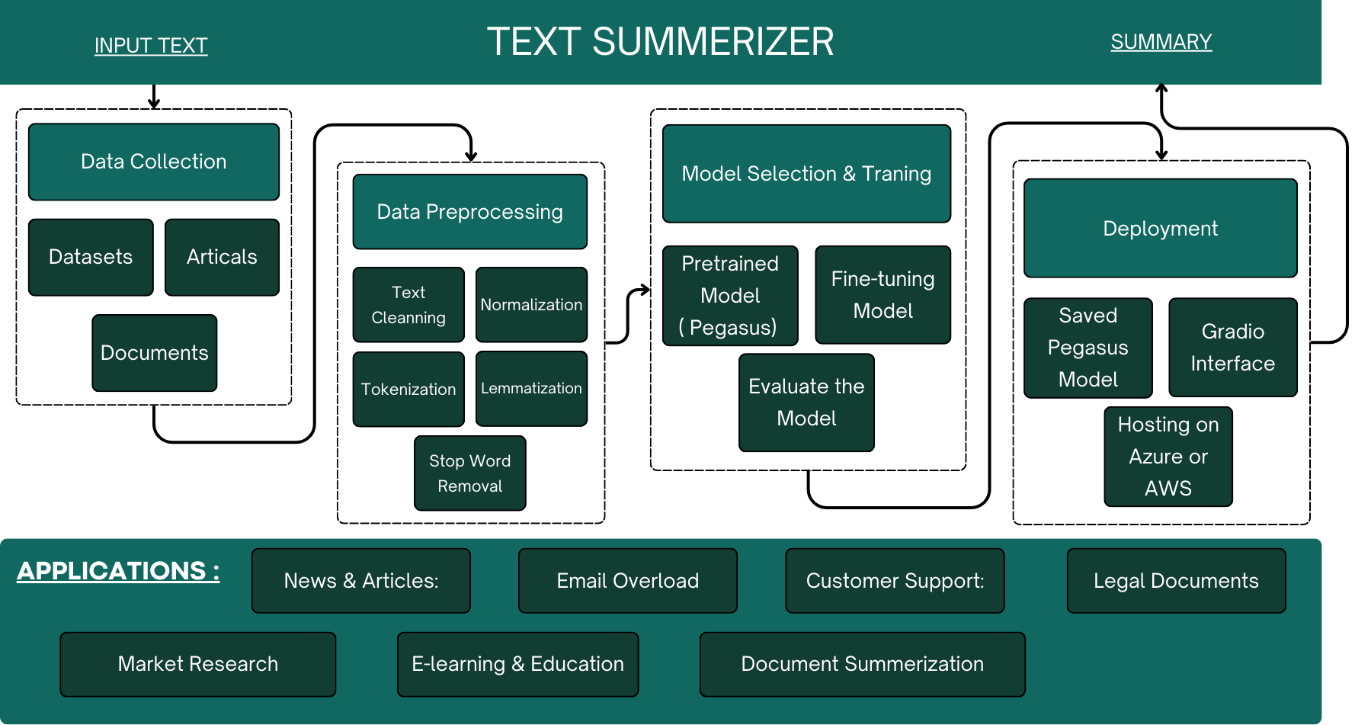
Proposal Workflow :
Fig. : Proposed Workflow
2024
Jain Nikhilkumar A
10

Slide 11
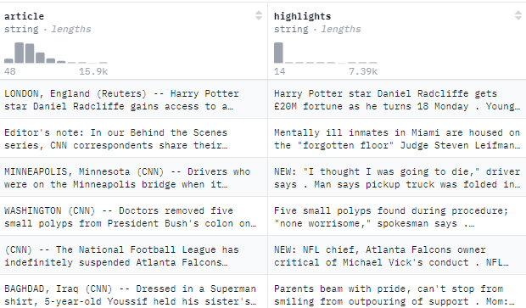
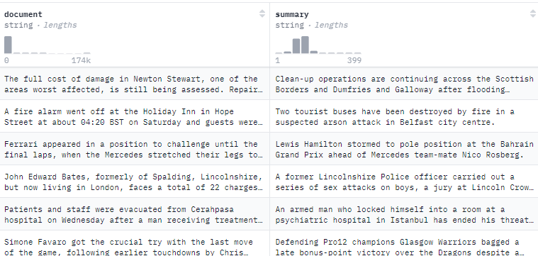

Proposal Dataset
CNN/Daily Mail Dataset
CNN/Daily Mail is a widely used dataset for text summarization, containing news articles and their corresponding human-written summaries.
It offers a large collection of text pairs, making it suitable for training deep learning models.
The dataset allows researchers to compare and evaluate different summarization algorithms.
Number of Documents:
Train: 287k Validation :13.4k Test: 11.4k Total : 226,711
XSum Dataset
XSum is another popular dataset for text summarization, consisting of extracted news articles and their corresponding summaries.
It focuses on longer documents than CNN/Daily Mail, offering a different challenge for summarization models.
XSum allows researchers to explore the task of summarizing longer and more complex texts.
Number of Documents:
Train: 204,045 Validation :11,332 Test: 11,334 Total : 226,711
2024
Jain Nikhilkumar A
11

Slide 12
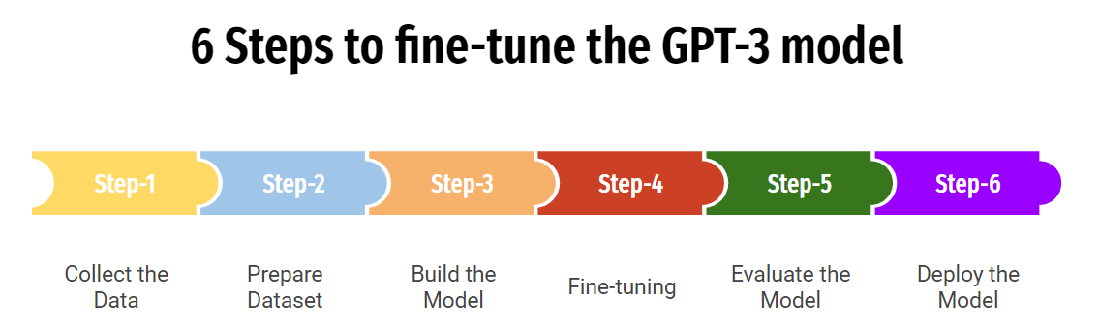
Proposal Model Training :
6 Steps to fine-tune the Pegasus Model
Challenge:
Limited Hardware Resources for Training large models requires significant computational power.
Your machine might not have enough resources to train a very large model effectively.
2024
Jain Nikhilkumar A
12

Slide 13



Model Training Process :
Initial Model Selection: BART-base
Pros:
Powerful transformer model with strong language understanding.
Cons:
Large size - can be resource-intensive for local machines, leading to:
Slow training times.
Memory limitations, potentially causing training failures.
Key Point: BART-base: Powerful But Resource-Intensive
Results and Next Step: Exploring Pegasus
Observations with T5:
Achieved baseline performance.
Key Point: T5 Results: Achieved Baseline Performance
Exploration:
Considered Pegasus, a model specifically designed for abstractive summarization.
Pros:
Optimized architecture for abstractive summarization tasks.
Potentially leads to higher quality and accuracy in summaries4
.
Key Point: Pegasus: Exploring Model Strength for Abstractive Summarization
Find the trained Models here:
https://drive.google.com/drive/folders/1WQnco5vI_6GoBoOaGbIcqpTuK_Rp6f6g?usp=sharing
Efficient Model Selection (T5)
Reasoning:
Switched to T5, a smaller and more efficient model.
Pros:
Faster training on your machine due to its smaller size.
More suitable for available hardware resources.
Key Point: T5: Efficient Model for Local Machine Training
Access GitHub Repository here :
https://github.com/Jain-nikhilkumar/-Text-Summarization-with-NLP
2024
Jain Nikhilkumar A
13

Slide 14
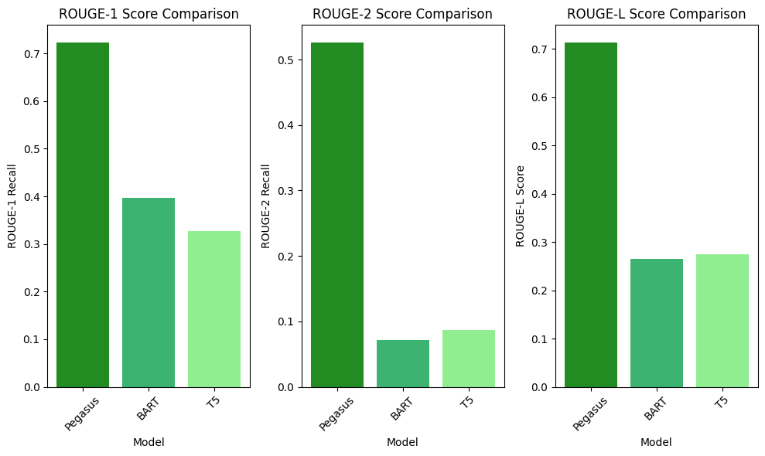
Proposal Model Evaluation :
Performance metrics –
ROUGE (Recall-Oriented Understudy for Gisting Evaluation):
Key metric for text summarization, measuring overlap between generated and reference summaries.
Focuses on Recall: Prioritizes capturing essential information.
Variants (e.g., ROUGE-1, ROUGE-2,ROUGE-L): Assess different aspects of overlap.
Complementary Options: BLEU (precision-focused).
Model's Performance:
ROUGE: Overlap with reference summaries
ROUGE-1: 0.7234
ROUGE-2: 0.5265
ROUGE-L: 0.7140
ROUGE-N: Measures the overlap of n-grams (contiguous sequences of n items) between the candidate summary and the reference summaries.
ROUGE-1:
Overlap of unigrams (single words).
ROUGE-2:
Overlap of bigrams (two-word sequences).
ROUGE-L:
Measures the longest common subsequence (LCS) between the candidate and reference summaries.
ROUGE-LSUM :
(LCS Summary) - variant of the ROUGE-L metric, specifically designed to evaluate the quality of summaries .
2024
Jain Nikhilkumar A
14

Slide 15
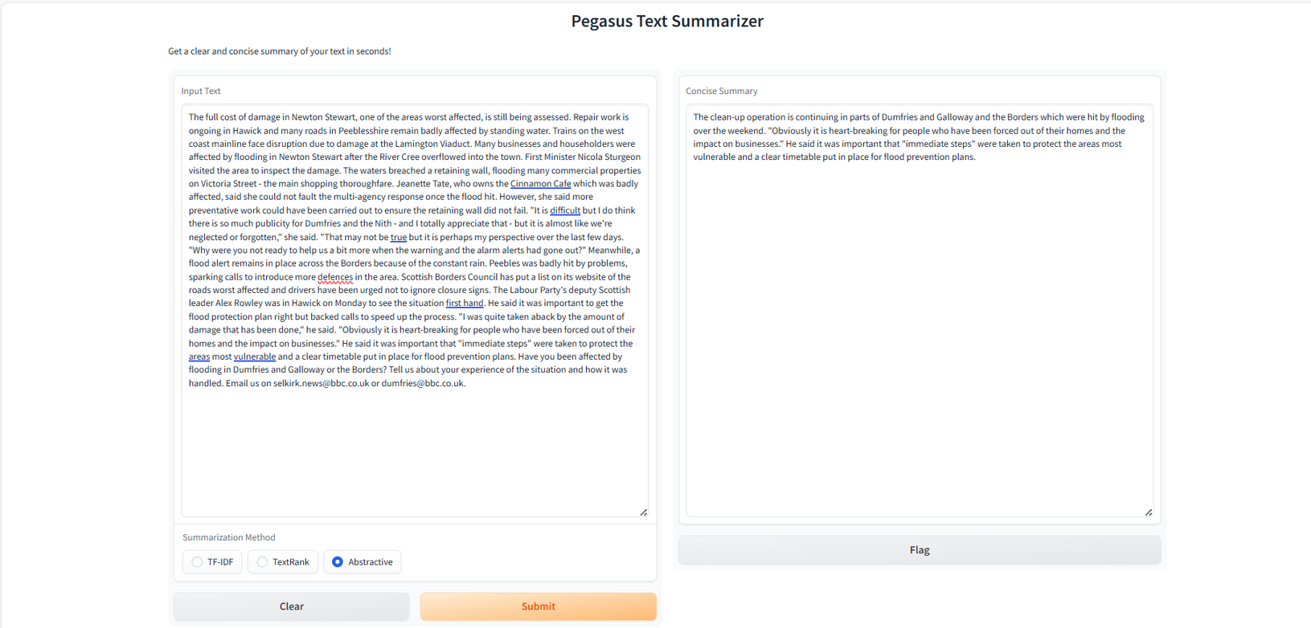
Proposal Testing :
Simple interface for the Deep Learning model, developed using Gradio.
Gradio is an open-source Python package that allows us to quickly build a demo - web-application for the trained models.
Enables us to test and even deploy the trained model.
Fig. Local Testing
2024
Jain Nikhilkumar A
15

Slide 16





Proposal Deployment:
Gradio lets you build web
interfaces for your models
with minimal code,
perfect for rapid prototyping
This is where you put your AI
model to work! Deploy your model
on Spaces, creating a web interface
for others to interact with and explore.
Share your model with a simple link!
Think of it as a giant library of
pre-trained AI models and
datasets, all accessible for free!
It's a community hub for machine
learning enthusiasts.
Visit Deployment at : https://huggingface.co/spaces/Nikhil2411/textsumerizar1234
2024
Jain Nikhilkumar A
16

Slide 17
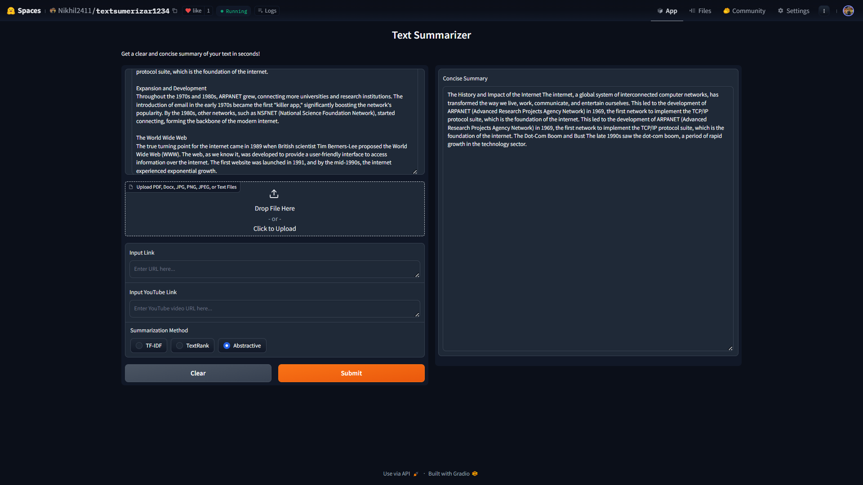
Proposal Deployment - Results :
Fig. Abstractive Summarizer Output
Visit Deployment at : https://huggingface.co/spaces/Nikhil2411/textsumerizar1234
2024
Jain Nikhilkumar A
17

Slide 18
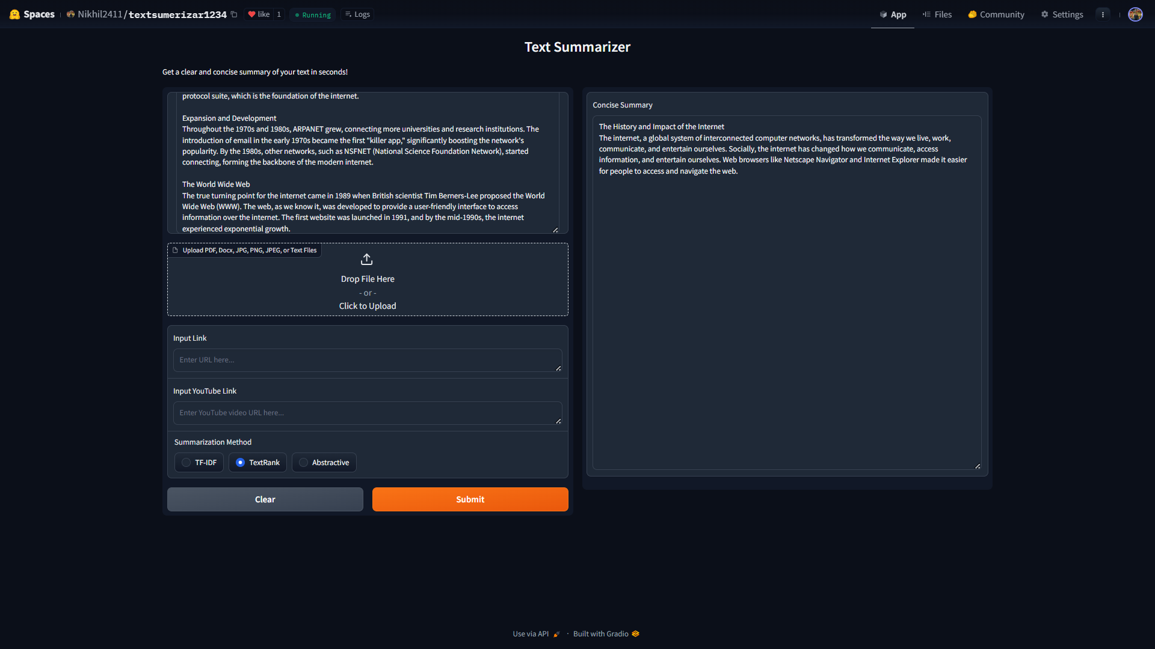
Proposal Deployment - Results :
Fig. Extractive Text Rank Summarizer Output
Visit Deployment at : https://huggingface.co/spaces/Nikhil2411/textsumerizar1234
2024
Jain Nikhilkumar A
18

Slide 19
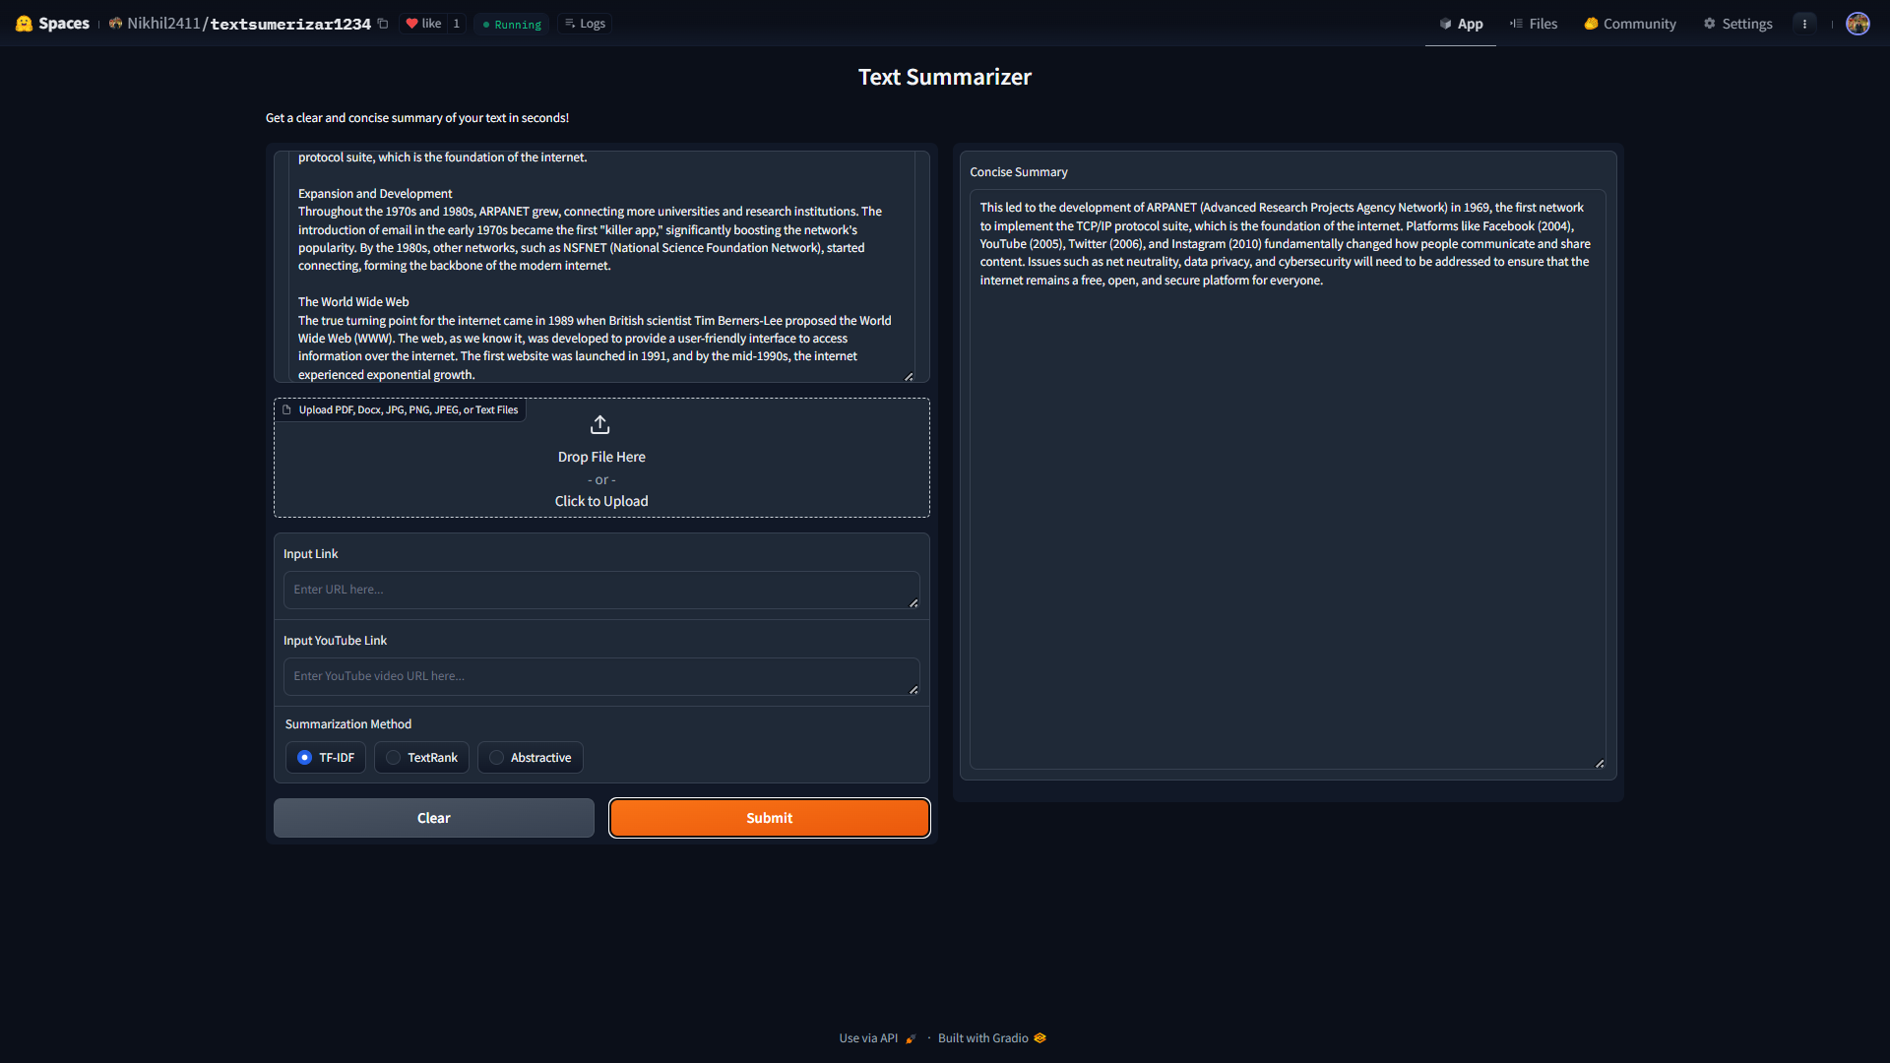
Proposal Deployment - Results :
Fig. Extractive TF-IDF Summarizer Output
Visit Deployment at : https://huggingface.co/spaces/Nikhil2411/textsumerizar1234
1
2024
Jain Nikhilkumar A
19

Slide 20
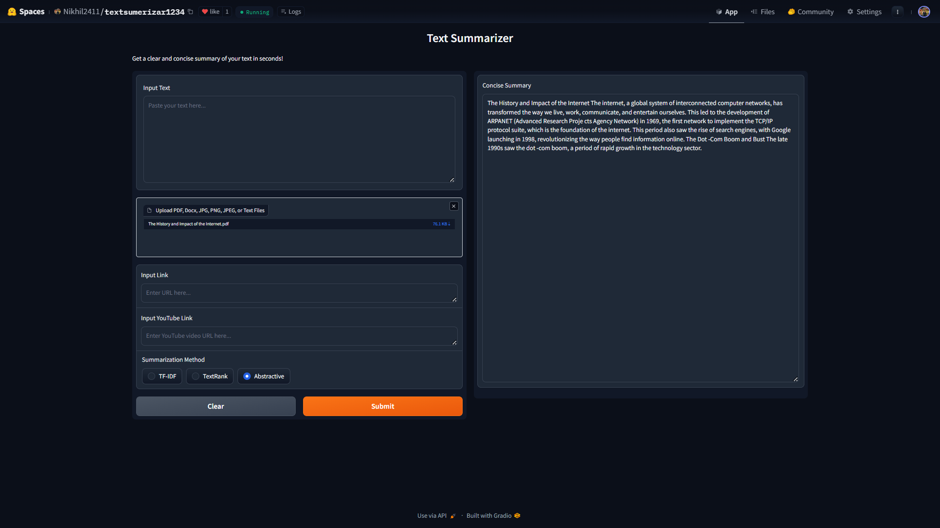
Proposal Deployment - Results :
Fig. Summarization with pdf file
Visit Deployment at : https://huggingface.co/spaces/Nikhil2411/textsumerizar1234
2024
Jain Nikhilkumar A
19

Slide 21
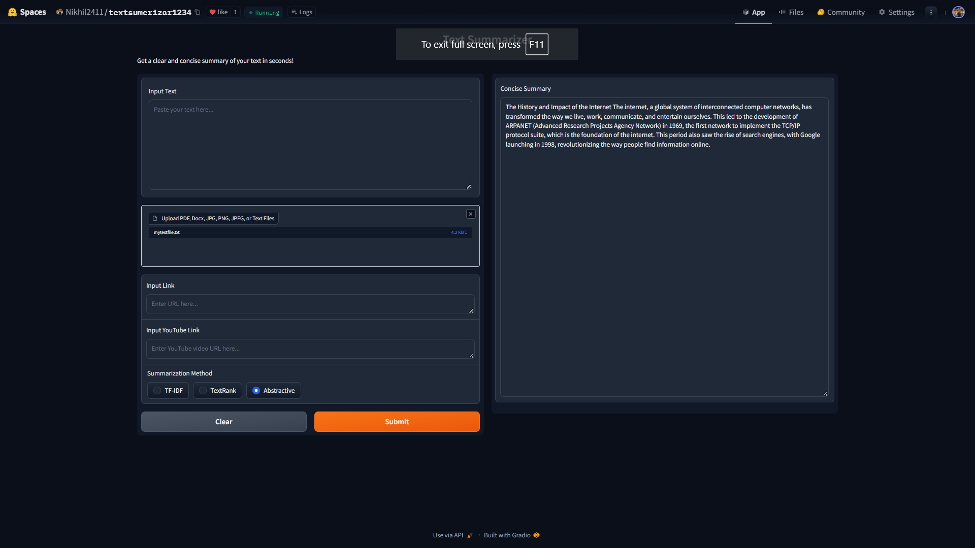
Proposal Deployment - Results :
Fig. Summarization with text file
Visit Deployment at : https://huggingface.co/spaces/Nikhil2411/textsumerizar1234
2024
Jain Nikhilkumar A
19

Slide 22
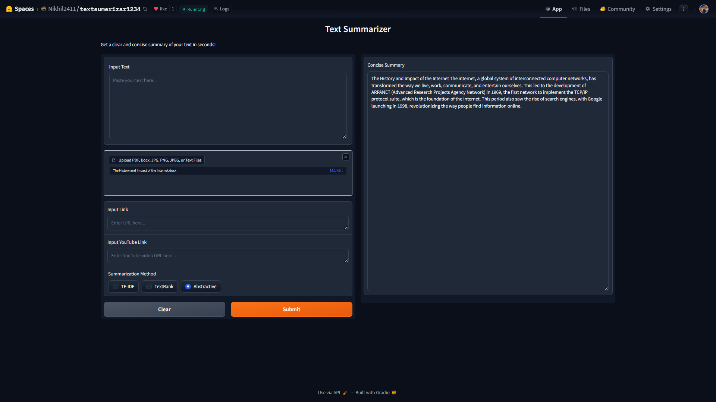
Proposal Deployment - Results :
Fig. Summarization with docx file
Visit Deployment at : https://huggingface.co/spaces/Nikhil2411/textsumerizar1234
2024
Jain Nikhilkumar A
19

Slide 23
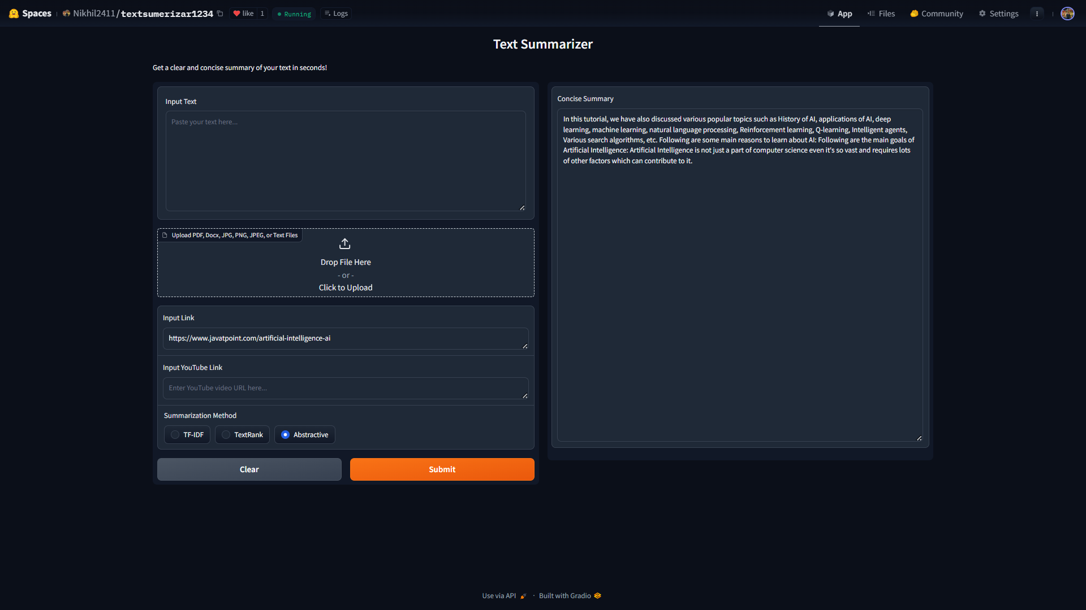
Proposal Deployment - Results :
Fig. Summarization with website link
Visit Deployment at : https://huggingface.co/spaces/Nikhil2411/textsumerizar1234
2024
Jain Nikhilkumar A
19

Slide 24
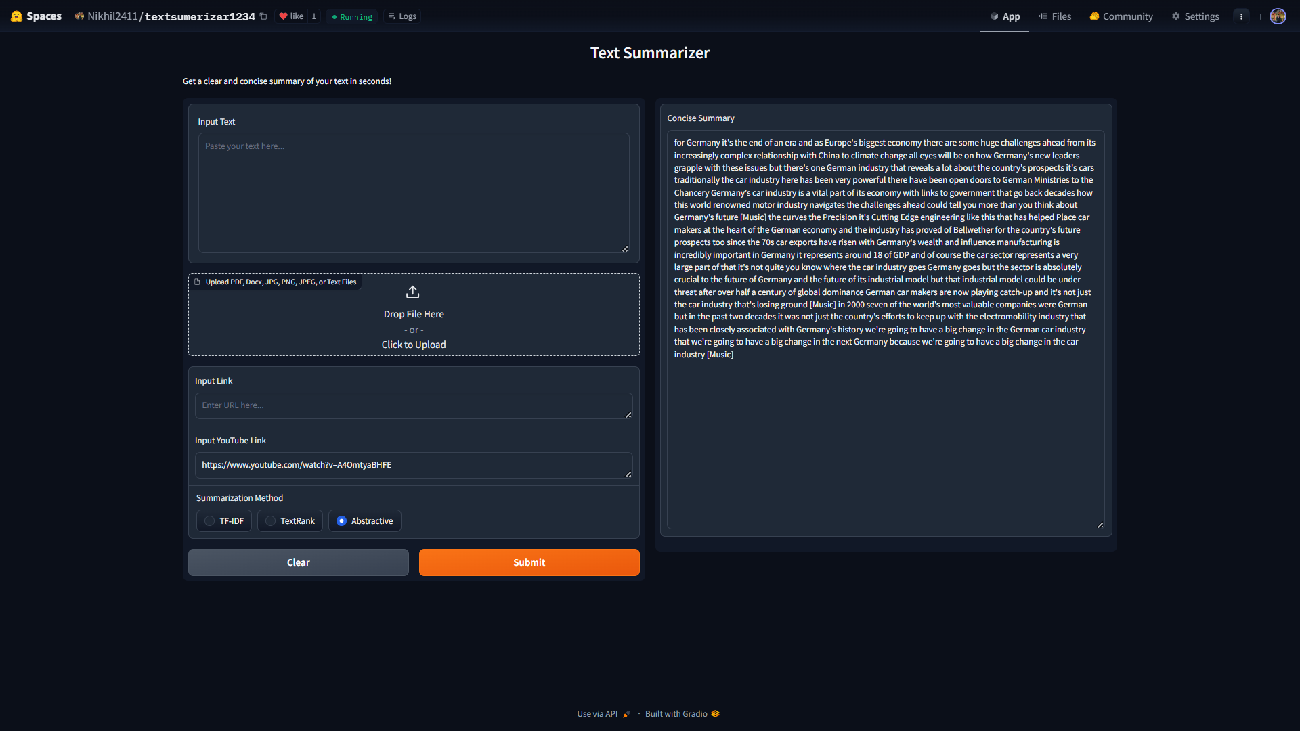
Proposal Deployment - Results :
Fig. Summarization with YouTube video link
Visit Deployment at : https://huggingface.co/spaces/Nikhil2411/textsumerizar1234
2024
Jain Nikhilkumar A
19

Slide 25





Real Life Applications
1. News Aggregation
2. Legal Document Review
3. Customer Support
4. Academic Research
Text summarization is extensively used in news aggregation platforms to deliver concise news summaries to readers. By summarizing lengthy articles, it helps users quickly grasp the main points of the news without having to read the entire content. This is particularly useful in today's fast-paced world where people want to stay informed but have limited time.
In the legal field, professionals often deal with extensive documentation. Text summarization can be applied to legal documents to extract key information, making it easier for lawyers and paralegals to review cases, contracts, and other legal texts. This saves significant time and effort, allowing legal professionals to focus on more critical aspects of their work.
Customer support centers can utilize text summarization to improve service efficiency. By summarizing customer inquiries, chat logs, and support tickets, support agents can quickly understand the context and provide accurate responses. Additionally, summarized insights from customer feedback can help businesses identify common issues and improve their products and services.
Researchers and students often need to go through numerous academic papers and articles. Text summarization tools can assist by generating concise summaries of research papers, helping them identify relevant studies more efficiently. This application enhances the research process by saving time and allowing researchers to focus on in-depth analysis of the most pertinent literature.
2024
Jain Nikhilkumar A
20

Slide 26





THANK TOU
For watching this presentation
Nikhilkumar Jain
7028244947
nikhilkumar1514@gmail.com
Dhule, Maharashtra
2024
Jain Nikhilkumar A
21

